Slide 1

INTRODUCTORY VOCABULARY
PHYSICAL EDUCATION

Slide 2
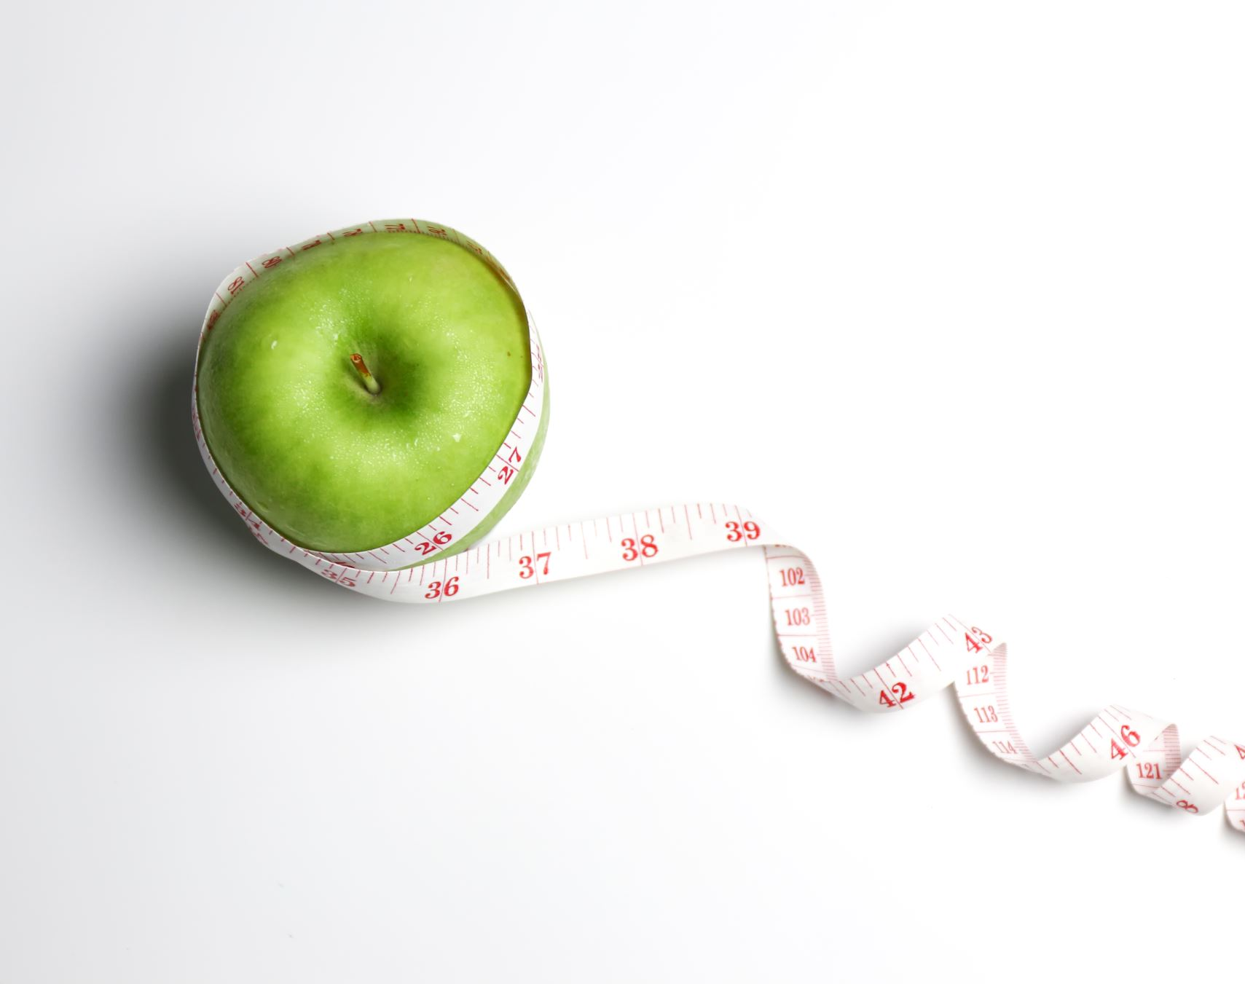
BODY COMPOSITION
The ratio of fat, muscle, and other tissues in the body.

Slide 3



CARDIOVASCULAR HEALTH
Relating to the heart and blood vessels; cardiovascular exercises include activities that increase heart rate.

Slide 4


FLEXIBILITY
The range of motion in joints and muscles.

Slide 5

MUSCULAR ENDURANCE
The ability to sustain physical activity for an extended period.

Slide 6

MUSCULAR STRENGTH
The ability of muscles to exert force against resistance.

Slide 7

FITNESS
The state of being physically healthy and in good shape.

Slide 8

EXERCISE
Physical activity performed to improve health, strength, and endurance.

Slide 9

HYDRATE
maintaining an adequate and balanced amount of water in the body to support its various physiological functions.

Slide 10

HEALTH
The overall condition of the body and mind, encompassing physical, mental, and social well-being.

